Slide 1


Need CE credit for this session?
Please don’t forget to
scan in to have your
attendance tracked.

Slide 2
To blend or not to blend?
Advantages of mixing ACT with new technologies
Ellen Excelmans (chair)
Mike Levin (discussant)

Slide 3
To blend or not to blend?
Learn2ACT – the handy life compass
Ellen Excelmans
Licensed Clinical Psychologist
www.learn2act.net

Slide 4
Disclosure:
I, Ellen Excelmans, have not received and will not receive any commercial support related to this presentation or the work presented in this presentation.

Slide 5

Help!
Our agendas bulge!
Too much demand for (individual) therapy
No crisismanagement
No consolidation after therapy
Too long in therapy
Notes:
Private practive for a broad spectrum of psychologic problems in a rural region in Flanders

Slide 6

Solution?
Notes:
Advantages mHealth:
Portable: people have their smartphone always with them
Monitoring & tracking: more liabele data: just-in-time & just-in-place
Possibility to push customized notifications
Support at the moment they need it the most

Slide 7

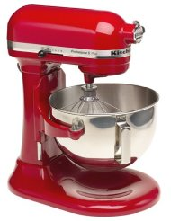
Blended ACT
Notes:
8 weeks group treatment + app for the right side of the hexaflex

Slide 8
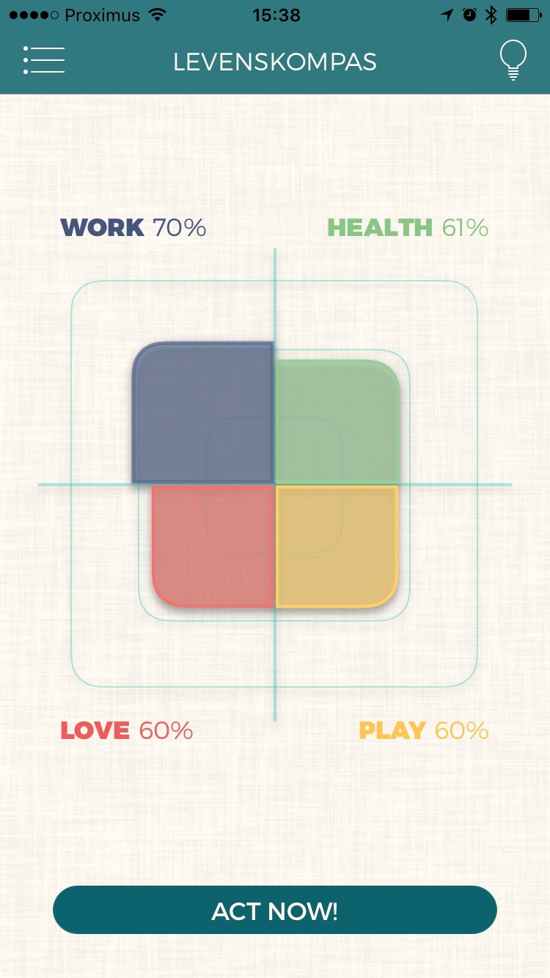
Learn2ACT functionalities
To blend or not to blend?

Slide 9
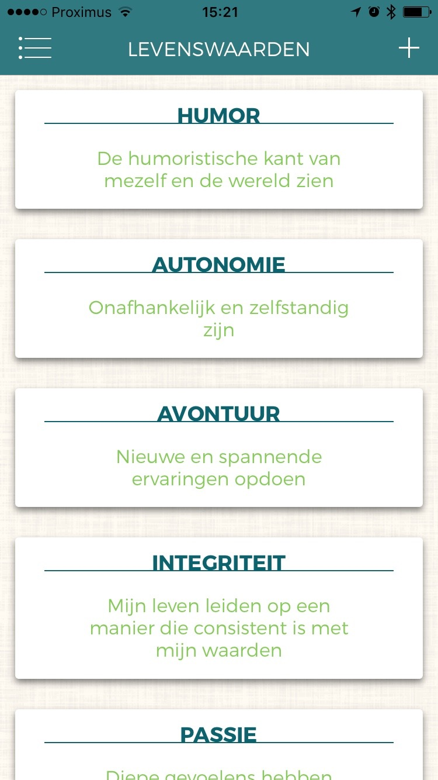
Value Sorting Task

Slide 10
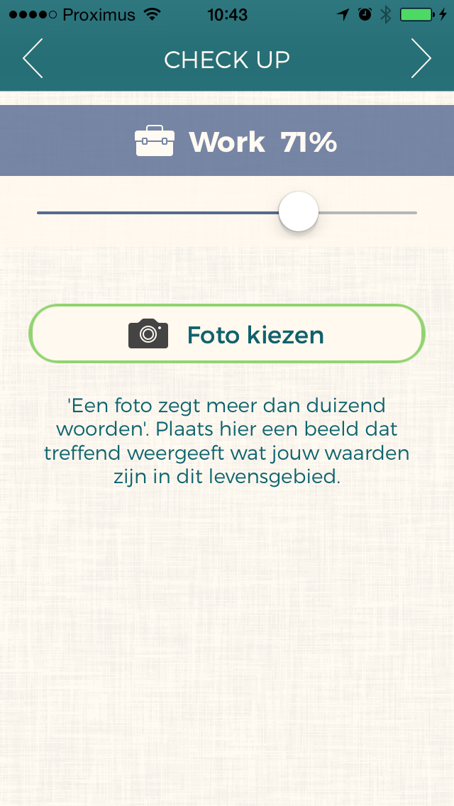
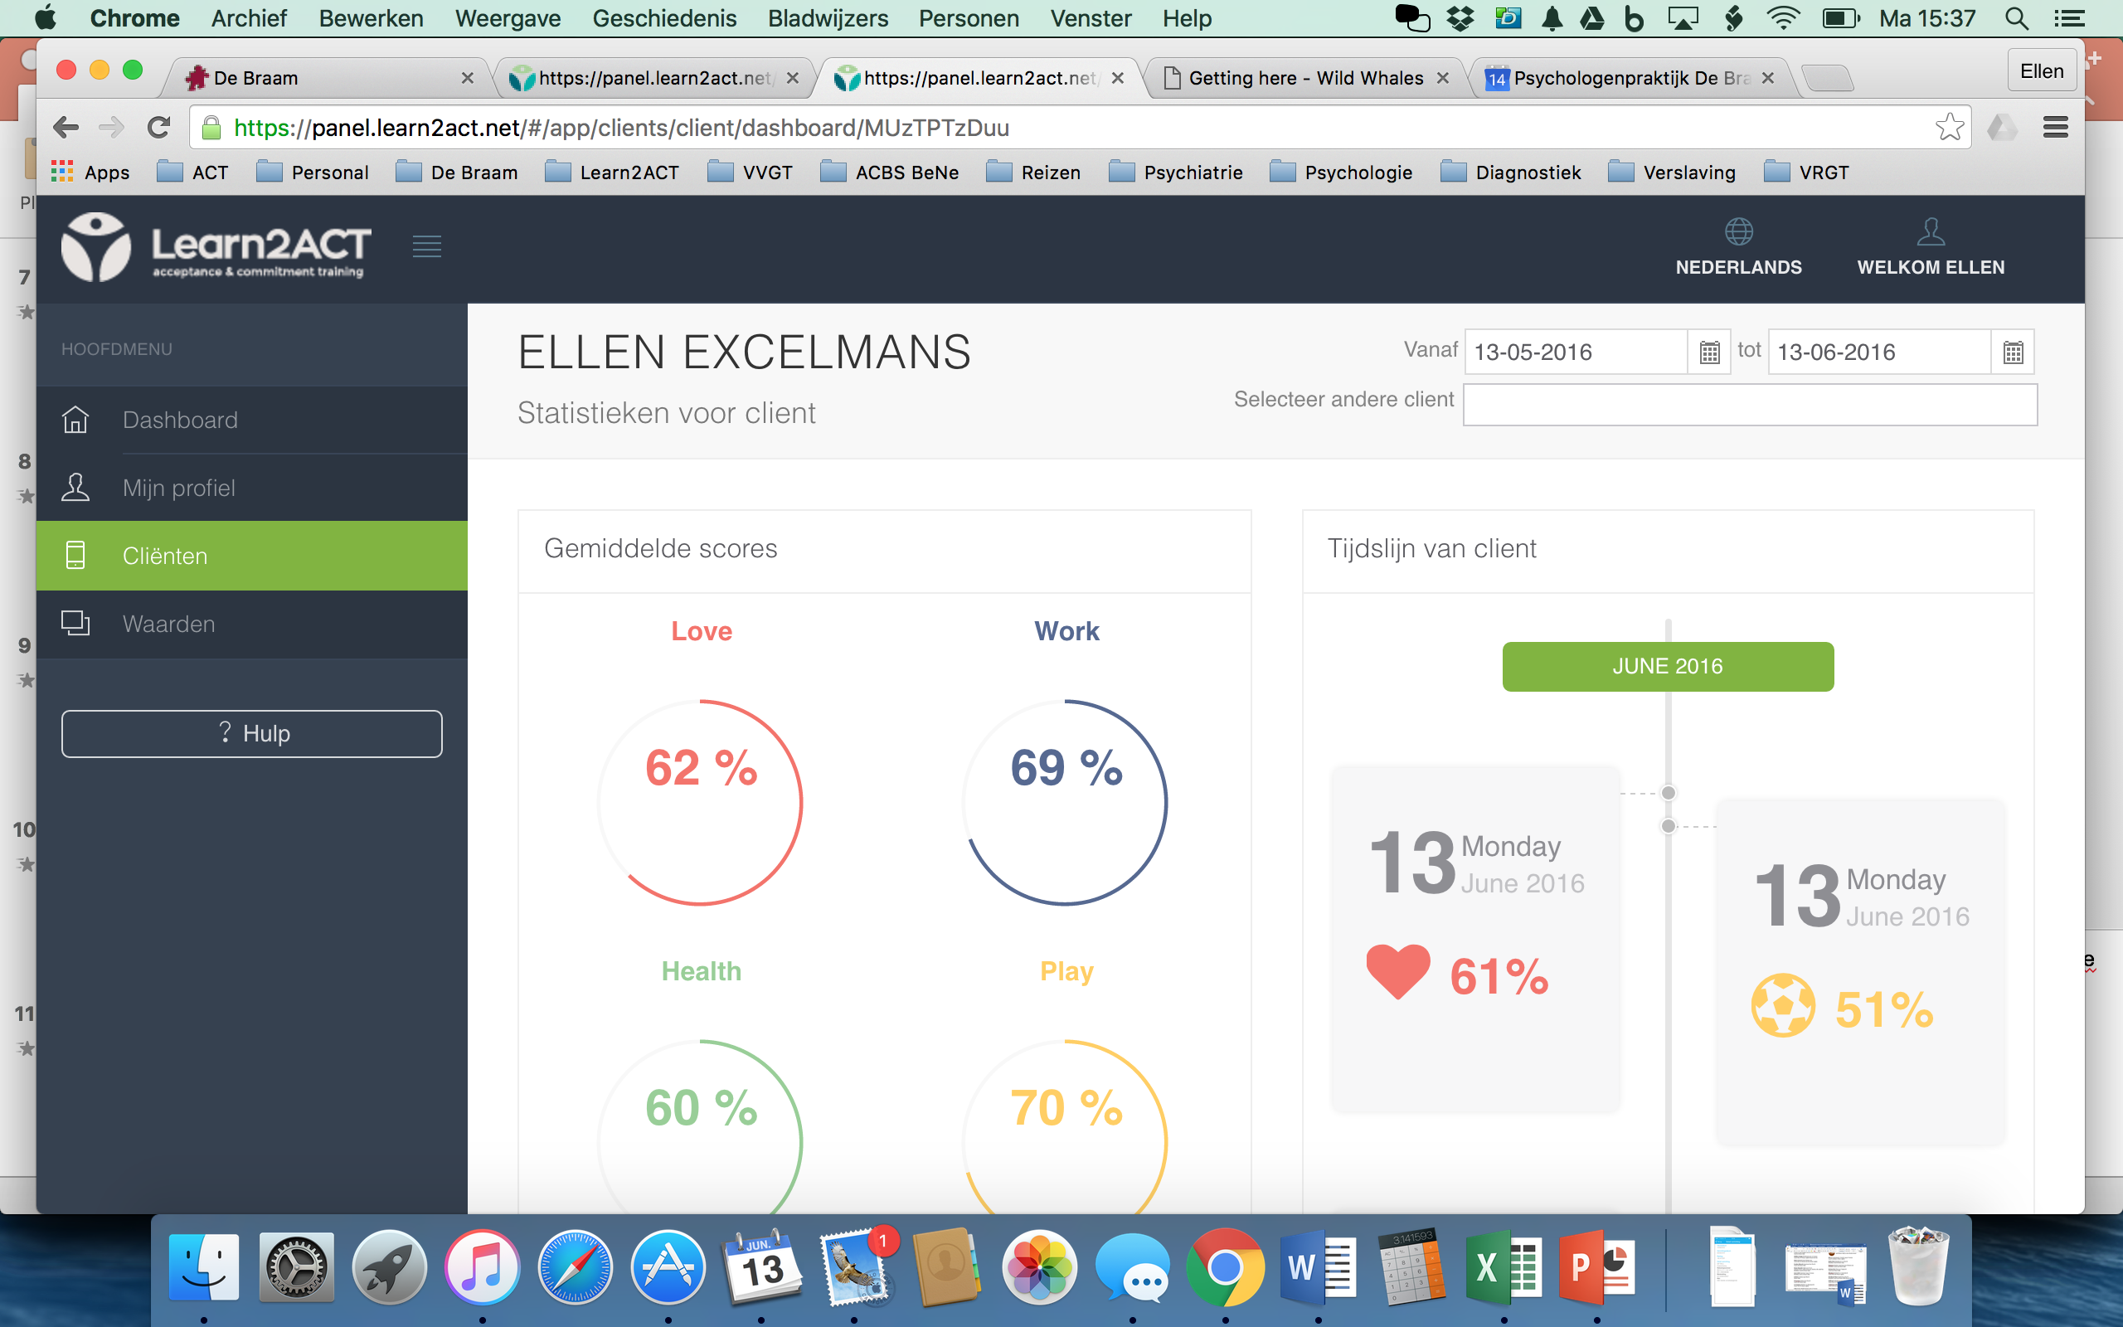
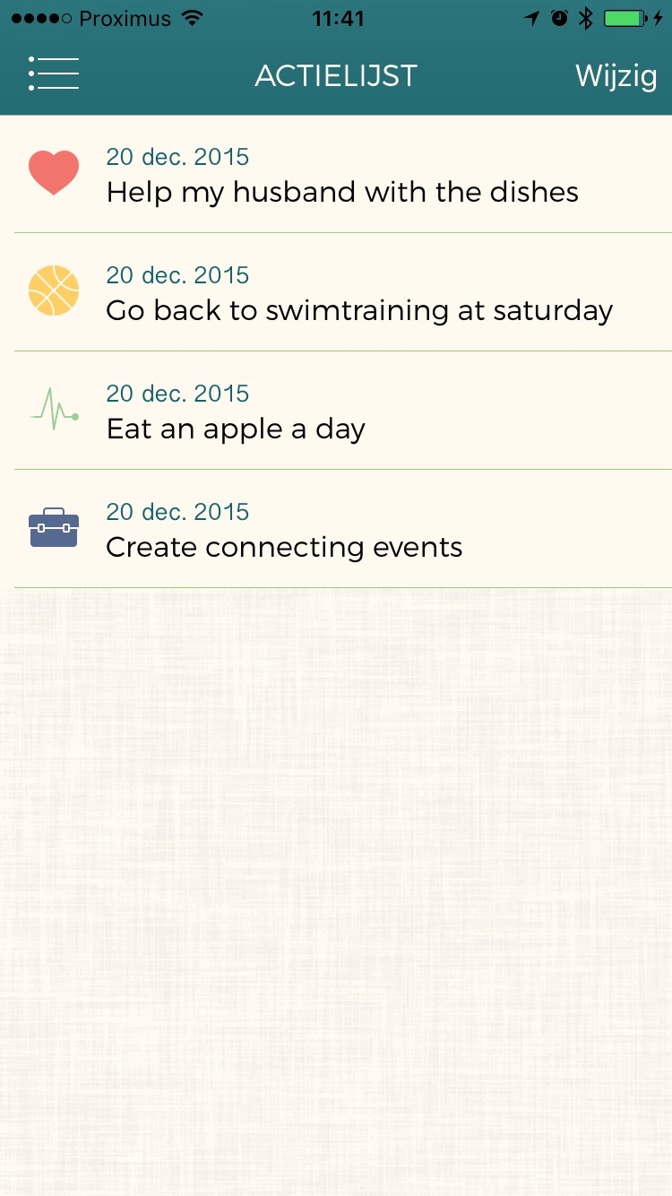
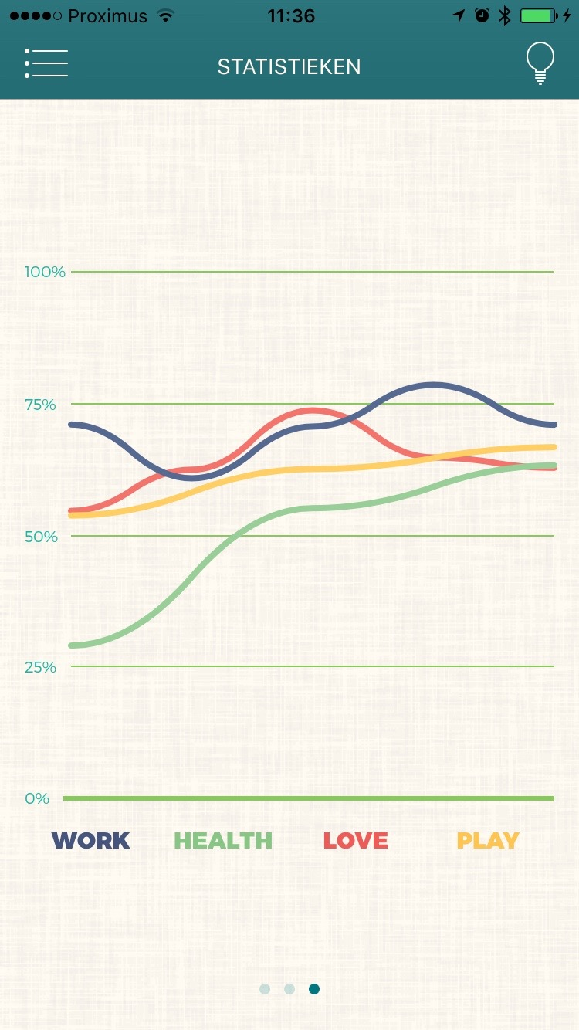
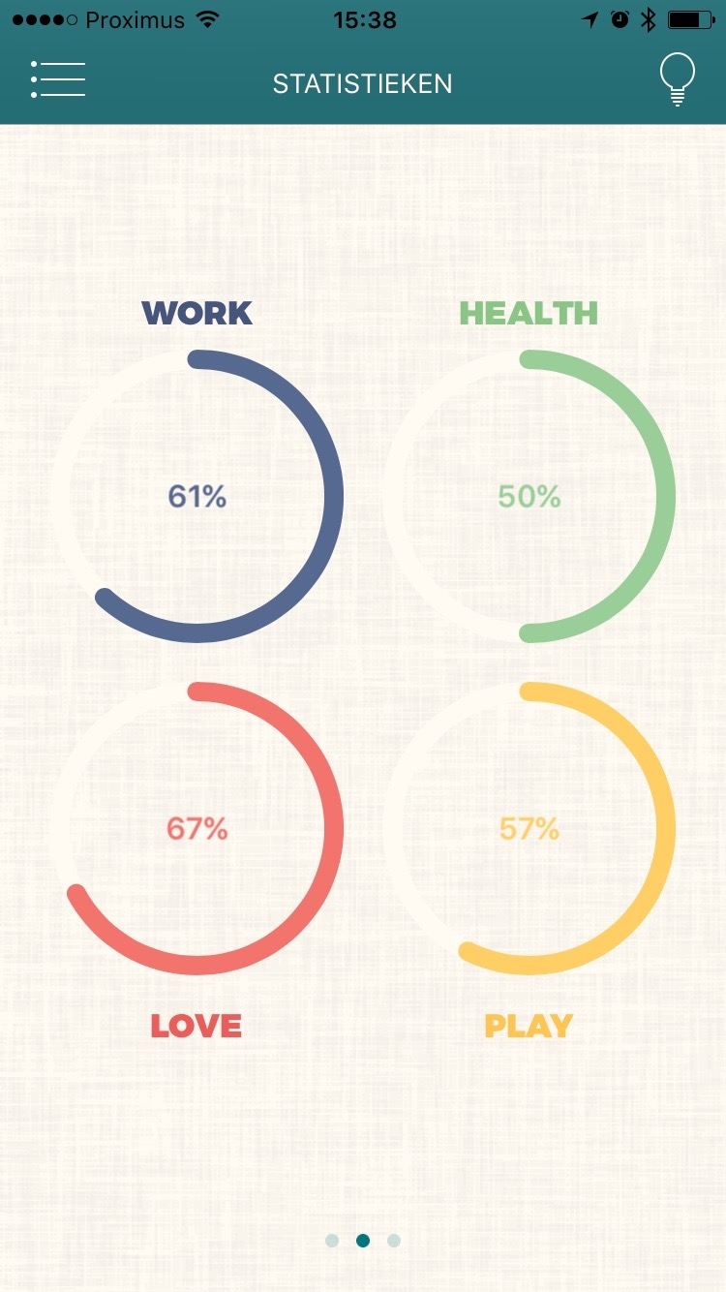
Self-monitoring & -control
Notes:
Weekly score of life quality: every week users are asked how well they live according their values on four live domains (work, love, play, health) and what they can do to bring this value more in their live
Goal setting and reminders: These value-bsed actions are kept in a to-do list and if they aren’t checked off within a week, users get an ACT-friendly reminder
Progress over time: users can also track their progress over time: in the statistics the can see their mean value scores and the evolution of their scores over time
Remote monitoring by therapist: these data are also available for the therapist: therapist will be notified if the value scores of their patients dramatically drop.

Slide 11
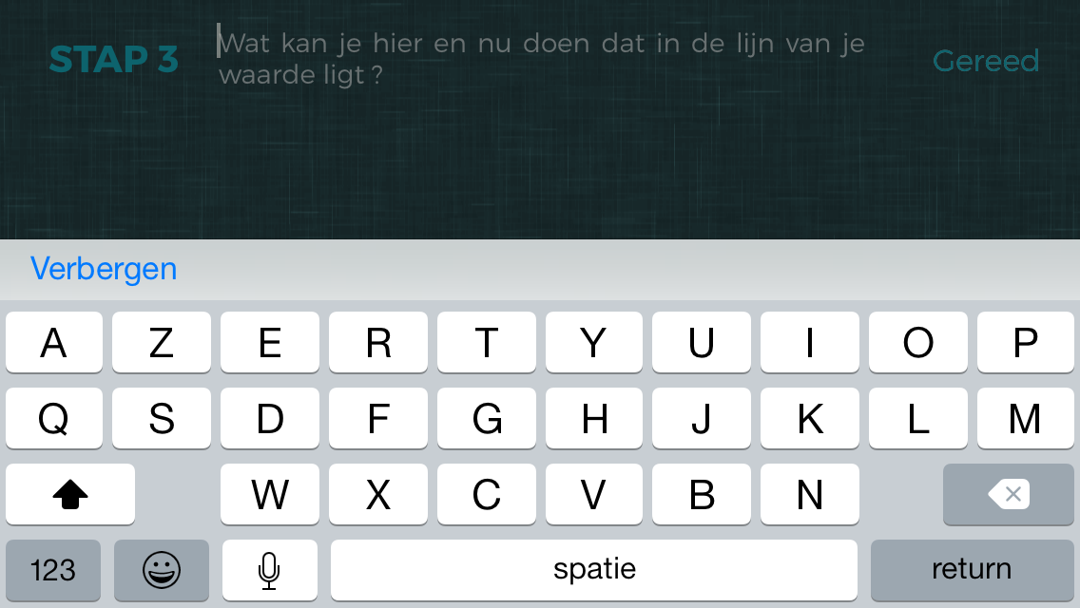
Crisis support
Notes:
ACT now button
Here and now exercise: users categorize their experience in a sensory versus a mental experience
Reminder of their values
What can you do here and now that lies in the line with your values?
Reminder of acquired skills in therapy/training

Slide 12
Prelimary Research findings
To blend or not to blend?

Slide 13



Added value of blending ACT?
Lack of research on this topic!
What is the added value of the Learn2ACT app on the satisfaction and the effectiveness of an ACT group treatment?
Notes:
The development of mobile apps is very costly + not much research on the effect of blended therapy -> added value?
BUT: problems in the recruitment of therapists/trainers who were willing to participate in the research
-> adjustment of the research question: profile and attitude of clients who are willing to use the Learn2ACT app
+ Attitude toward technologies

Slide 14
Intake
Start
End
8 weeks group treatment
Pre-test
OQ-45
VLQ-NL
FIT-60
UTAUT-NL
Post-test
OQ-45
VLQ-NL
FIT-60
23 participants of 3 groups
OQ-45: 78.1 (26.2)
VLQ-NL: 5.5 (2.0) – 6.7 (2.1)
FIT-60: 176.8 (54.2)
Notes:
OQ-45: Outcome questionnaire: psychosocial problems (0;4)
Symtomatic distress (0;100)
Interpersonal relationships (0;44)
Social role (0;36)
Total (0;180)
VLQ-NL: satisfaction in 10 life domains (1;10)
FIT-60: psychological flexibility: 6 processes (0;60) + totale score (0;360)
UTAUT: Unified Theory of Acceptance and Use of Technology
Performance expectation: (0;12)
Effort expectation (0;8)
Facilitating conditions (0;20)
Data security (0;4)
IT knowledge (0;4)
Post-test: hold your nerve inquiry: 12,0%

Slide 16
To app or not to app?
UTAUT-NL | M | SD | Min | Max
Performance Expectation | 2.4 | 0.9 | 0.0 | 4.0
Effort Expectation | 2.1 | 0.8 | 0.5 | 4.0
Facilitating Conditions | 2.5 | 0.8 | 1.0 | 4.0
Data Security | 2.3 | 1.2 | 0.0 | 4.0
ICT Knowledge | 2.3 | 0.9 | 0.0 | 4.0
Van Mele, Van Daele & Excelmans (2016).
Notes:
Participants are willing to try it out
ANOVA-analysis:
Performance Excpectation: vrouwen (2.5; 0.76) > mannen (1.5; 1.04) – p = .076
Effort Expectation: hoger opleidingsniveau (2.24;0.64) < lager opleidingsniveau (0.5; 0.0)
Geen significante verschillen voor leeftijd en burgelijke staat

Slide 17

Initially, the extra workload scared me. But it isn’t so bad. On the contrary, it saves time because I can give the app to those clients who don’t really need me anymore…
I was a little bit afraid when the group ended. The app made me feel I always could fall back on something.
All my ACT-tools are now at hand
I really like the ACT now button: I practice every day when I travel to work.

Slide 18
Challenges
“Our clients are totally ready for new technologies,
but our therapists aren’t”
Notes:
Our biggest challenge was convincing therapists to step into the trial.
Explorative research on the attitude towards technology innovations in mental health care in Flanders (2015)
Performance expectation: 4.87 (1;7)
Effort expectation: 4.75 (1;7)
Attitude toward technologies: 4.65 (1;7)
Social influence: 3.73 (1;7)
Facilitating conditions: 3.58 (1;7)
Self-reliance: 4.38 (1;7)
Fear: 2.75 (1;7)
Use intention: 4.02 (1;7)
Research Van Daele, Vansteenwegen, Hermans, Van Audenhove, & Van den Bergh (2013): nurses and GP’s: SWOT-analysis
Weakness: no time for support, technologie problems, extra workload, not individualized, dependent of motivation of users
Threaths: not their job, too much protocol-based, alienation of reality, what with suicidality?

Slide 19
Conclusions
Blended ACT is promising: the best of 2 worlds:
  Bridging between sessions
  Optimal use of the sessions
  More binding -> less drop-out
More research is needed
Clients are willing to use Learn2ACT
And now their therapists…

Slide 20


Try it out?
Download our app and ask for a free account:
info@learn2act.net

Slide 21
Need credit for this session?
Please don’t forget to scan out.
What did you think?....
complete the 3 question quickeval
for this session at
https://contextualscience.org/quickeval
This was presentation was session 105

